Slide 1
CHAPTER 1
The Miniature Capital System
Part I · The Problem of Capital
K
→
𝒢
→
Q
→
Ξ
Mathematical Theory of Capital · Companion Course

Slide 2
Chapter at a glance
The smallest model in which two systems agree on every scalar reading yet differ in value. The architecture premium 5.5 is the value of a pathway the scalar cannot see.
The laboratory module
Module 1 — The Miniature Capital System · Waterfall, premium curve, additivity
◈
Notebook
Rendered, with charts
▤
Workbook
Live Excel formulas
▦
Webapp
Interactive module

Slide 3
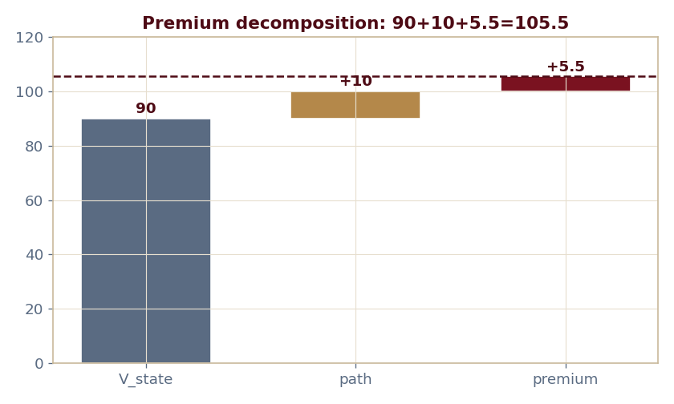
The key result
Every number reproduced by the seeded engine — notebook, workbook, and webapp agree by construction.

Slide 4
What the module computes
State value 90 + path increment 10 + architecture premium 5.5 = 105.5
The premium is (7.5−κ)⁺, dying at the minting cost κ*=7.5
Two independent pathways add: 6.5 = 5.5 + 1
System A and System B tie on every scalar D⁰ reading
ch01 · 8/8 PASS
Validation checks accompany every laboratory report.

