Slide 1
CHAPTER 2
The Aggregation Problem
Part I · The Problem of Capital
K
→
𝒢
→
Q
→
Ξ
Mathematical Theory of Capital · Companion Course

Slide 2
Chapter at a glance
The Cambridge reswitching example: the cost-minimizing technique is not monotone in the interest rate. A scalar ordering of capital fails.
The laboratory module
Module 2 — The Aggregation Problem · Cost curves and reswitching
◈
Notebook
Rendered, with charts
▤
Workbook
Live Excel formulas
▦
Webapp
Interactive module

Slide 3
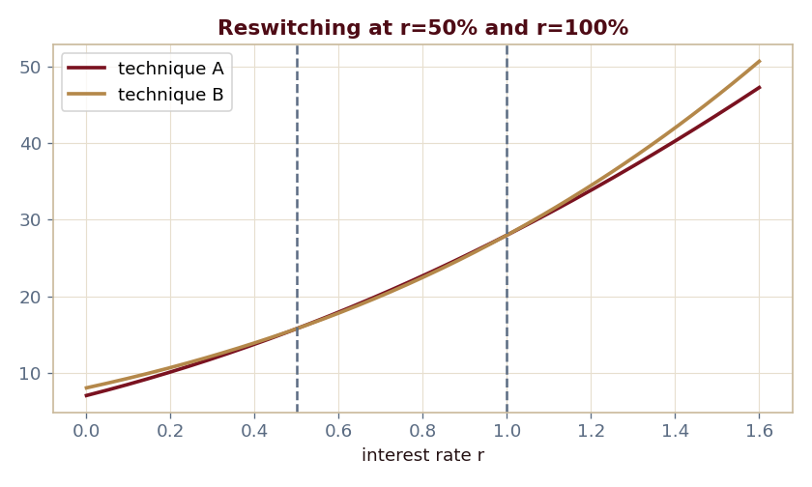
The key result
Every number reproduced by the seeded engine — notebook, workbook, and webapp agree by construction.

Slide 4
What the module computes
Technique A cheaper, then B, then A again
Switch points at r = 50% and r = 100%
Two sign changes in the cost difference c_B − c_A
No scalar orders the techniques across all rates
ch02 · 8/8 PASS
Validation checks accompany every laboratory report.

