Slide 1
CHAPTER 3
The Capital State & Scalar Impossibility
Part I · The Problem of Capital
K
→
𝒢
→
Q
→
Ξ
Mathematical Theory of Capital · Companion Course

Slide 2
Chapter at a glance
The tie-chain: a monotone scalar φ=2k₁+3k₂ is marched across a gate by the ladder identity until the right endpoint crosses while the left stays out — a witnessed contradiction.
The laboratory module
Module 3 — Representation & Projections · The tie-chain witness
◈
Notebook
Rendered, with charts
▤
Workbook
Live Excel formulas
▦
Webapp
Interactive module

Slide 3
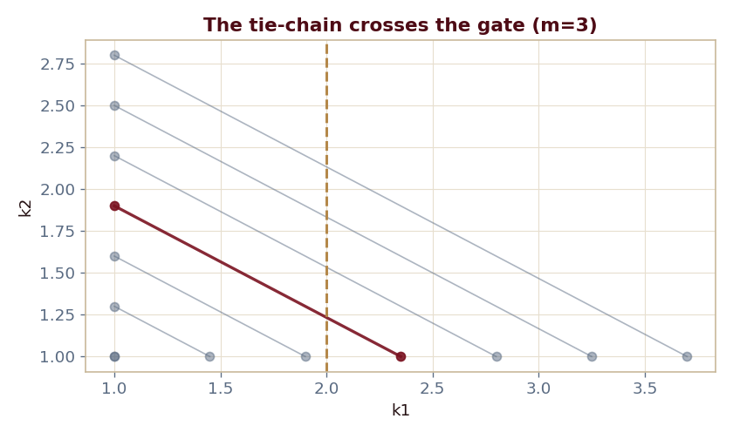
The key result
Every number reproduced by the seeded engine — notebook, workbook, and webapp agree by construction.

Slide 4
What the module computes
Every rung is a genuine tie (φ equal on both endpoints)
The gate θ=2 crosses at m=3
φ=7.7 on both endpoints at the crossing
No monotone scalar is gate-consistent
ch03 · 8/8 PASS
Validation checks accompany every laboratory report.

