Slide 1
CHAPTER 5
The Transformation Network
Part II · Transformation
K
→
𝒢
→
Q
→
Ξ
Mathematical Theory of Capital · Companion Course

Slide 2
Chapter at a glance
The signature network, founded. Four reachability strata from [Private]; the viability gap is exactly {[Securitized]} — reachable in law but not in grounded financing.
The laboratory module
Module 5 — The Network Explorer · Strata, Kleene iterations, the gap
◈
Notebook
Rendered, with charts
▤
Workbook
Live Excel formulas
▦
Webapp
Interactive module

Slide 3
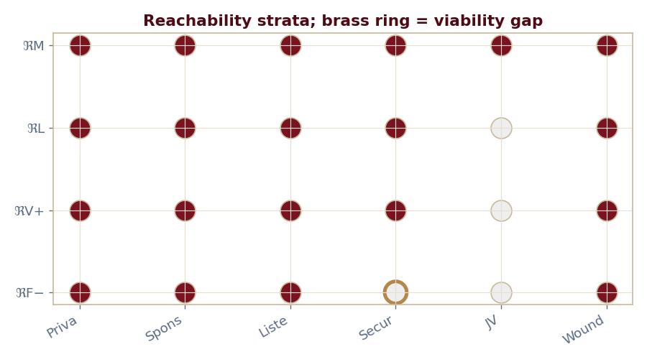
The key result
Every number reproduced by the seeded engine — notebook, workbook, and webapp agree by construction.

Slide 4
What the module computes
Four strata: engineer, lawyer, growth banker, credit banker
Viability gap = {[Securitized]}
Kleene bottom cap 12 < cost 13 (not grounded)
Kleene top cap 14 ≥ cost (reachable optimistically)
ch05 · 8/8 PASS
Validation checks accompany every laboratory report.

