Slide 1
CHAPTER 6
The Algebra of Transformations
Part II · Transformation
K
→
𝒢
→
Q
→
Ξ
Mathematical Theory of Capital · Companion Course

Slide 2
Chapter at a glance
Order matters. From (7,8) both orders of list and securitize are feasible but land on different states; from (5,8) only one order completes at all.
The laboratory module
Module 6 — The Program Composer · Commutation failures
◈
Notebook
Rendered, with charts
▤
Workbook
Live Excel formulas
▦
Webapp
Interactive module

Slide 3
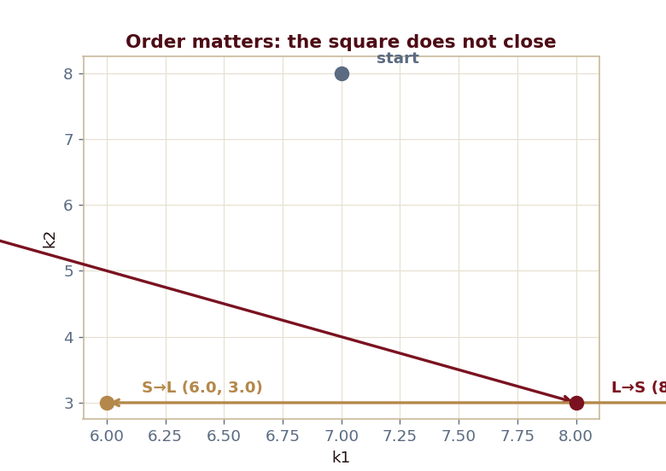
The key result
Every number reproduced by the seeded engine — notebook, workbook, and webapp agree by construction.

Slide 4
What the module computes
L-then-S → (8,3) vs S-then-L → (6,3)
The square does not close: transformations do not commute
From (5,8): domain asymmetry, only one order valid
Programs form a monoid, not an abelian group
ch06 · 8/8 PASS
Validation checks accompany every laboratory report.

