Slide 1
CHAPTER 7
The Geometry of Transformation
Part II · Transformation
K
→
𝒢
→
Q
→
Ξ
Mathematical Theory of Capital · Companion Course

Slide 2
Chapter at a glance
Distance before price. A cost gauge makes transformation a directed quasi-metric; ownership is a ratchet — cheap out, dear back.
The laboratory module
Module 7 — The Geometer · The distance quasi-metric
◈
Notebook
Rendered, with charts
▤
Workbook
Live Excel formulas
▦
Webapp
Interactive module

Slide 3
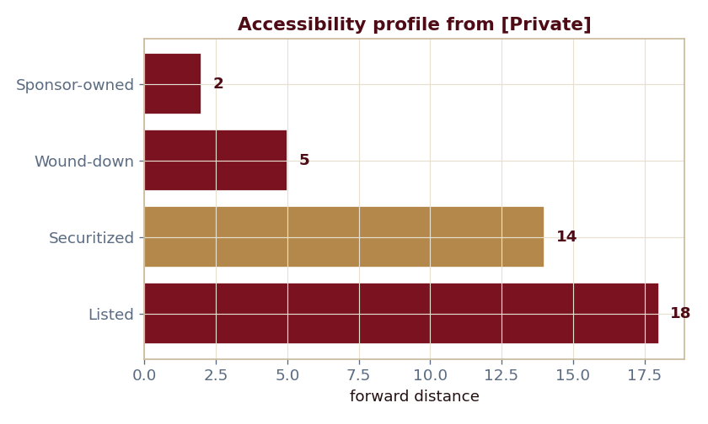
The key result
Every number reproduced by the seeded engine — notebook, workbook, and webapp agree by construction.

Slide 4
What the module computes
Priv→Spon = 2, but Spon→Priv = 25 (the ratchet)
Priv→Sec = 14, Priv→List = 18
Accessibility spectrum {0, 2, 5, 14, 18}
Covenant pruning drops [Securitized] at radius 14
ch07 · 8/8 PASS
Validation checks accompany every laboratory report.

