Slide 1
CHAPTER 9
Architecture Value & Separation
Part III · Valuation
K
→
𝒢
→
Q
→
Ξ
Mathematical Theory of Capital · Companion Course

Slide 2
Chapter at a glance
The flagship: value separates into state, pathways, and the capacity to make pathways. Architecture value is compound-option value on an unrolled architecture — exactly.
The laboratory module
Module 9 — The Separation Bench · Unrolling, meta-states
◈
Notebook
Rendered, with charts
▤
Workbook
Live Excel formulas
▦
Webapp
Interactive module

Slide 3
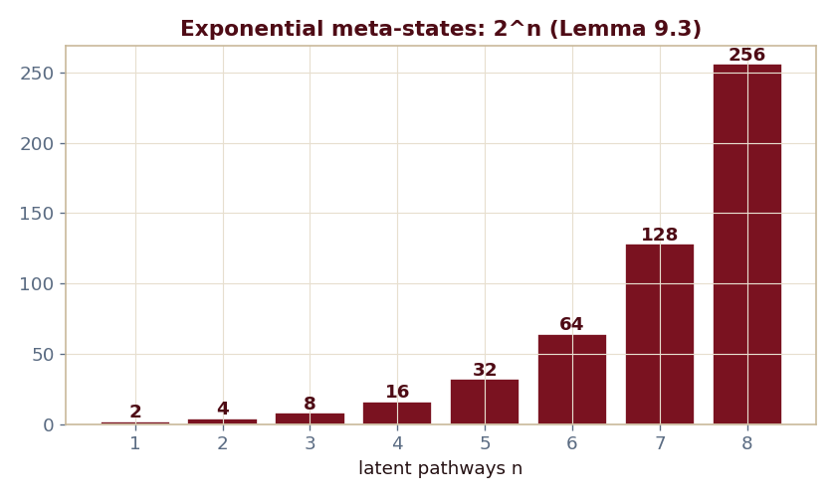
The key result
Every number reproduced by the seeded engine — notebook, workbook, and webapp agree by construction.

Slide 4
What the module computes
The miniature's 5.5 = compound option on the unrolled graph
n latent pathways → 2ⁿ meta-states (Lemma 9.3)
The unrolling is exponentially expensive
Ξ is, at minimum, an exponentially compressed object
ch09 · 8/8 PASS
Validation checks accompany every laboratory report.

