Slide 1
CHAPTER 11
Capital Formation
Part IV · Formation, Degeneration, Crisis
K
→
𝒢
→
Q
→
Ξ
Mathematical Theory of Capital · Companion Course

Slide 2
Chapter at a glance
Where systems come from. Formation is four-dimensional production from the null system. Two jurisdictions, two formation-depth profiles.
The laboratory module
Module 11 — The Foundry · Founding ledger, greedy gap
◈
Notebook
Rendered, with charts
▤
Workbook
Live Excel formulas
▦
Webapp
Interactive module

Slide 3
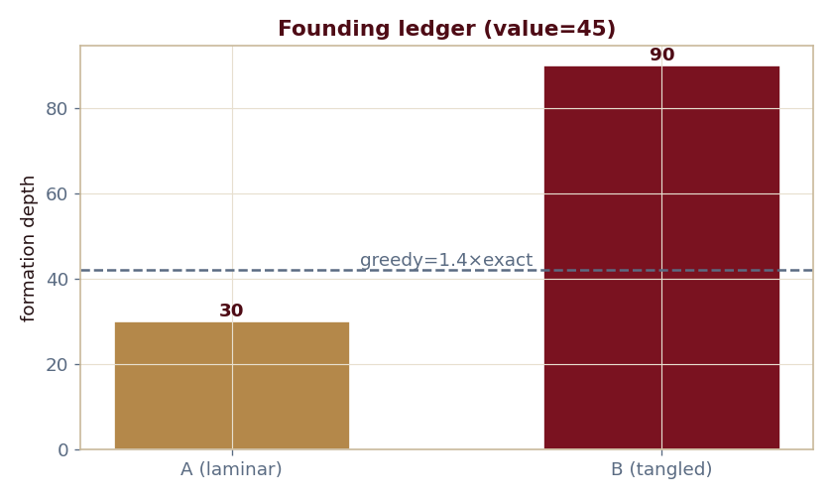
The key result
Every number reproduced by the seeded engine — notebook, workbook, and webapp agree by construction.

Slide 4
What the module computes
Jurisdiction A (laminar): depth 30, 0 approvals
Jurisdiction B (tangled): depth 90, 2 approvals
Greedy pays 1.4× the exact optimum on B
Gauged founding value = 45
ch11 · 8/8 PASS
Validation checks accompany every laboratory report.

