Slide 1
CHAPTER 12
Measurement & Degeneration
Part IV · Formation, Degeneration, Crisis
K
→
𝒢
→
Q
→
Ξ
Mathematical Theory of Capital · Companion Course

Slide 2
Chapter at a glance
Seeing the quadruple and watching it die. A capital system can die structurally while every scalar the accounts report stays green.
The laboratory module
Module 12 — The Observatory · The degeneration dashboard
◈
Notebook
Rendered, with charts
▤
Workbook
Live Excel formulas
▦
Webapp
Interactive module

Slide 3
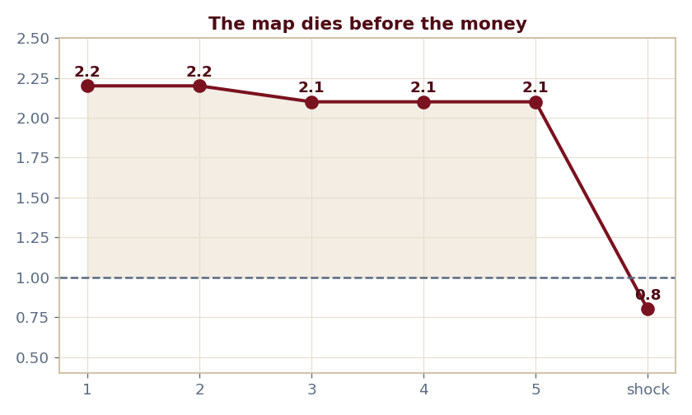
The key result
Every number reproduced by the seeded engine — notebook, workbook, and webapp agree by construction.

Slide 4
What the module computes
Coverage holds ~2.1 through five quarters of collapse
Cliffs to 0.8 only at the shock
The map dies one period before the money
Channels: meta, architectural, informational
ch12 · 8/8 PASS
Validation checks accompany every laboratory report.

