Slide 1
CHAPTER 13
Crisis: Coupled Networks
Part IV · Formation, Degeneration, Crisis
K
→
𝒢
→
Q
→
Ξ
Mathematical Theory of Capital · Companion Course

Slide 2
Chapter at a glance
Two networks, one fire. Shortfalls force sales; sales load routes and mark neighbors; the coupled system clears at a fixed point — orderly or spiral.
The laboratory module
Module 13 — The Fire Bench · Coupled clearing, the route book
◈
Notebook
Rendered, with charts
▤
Workbook
Live Excel formulas
▦
Webapp
Interactive module

Slide 3
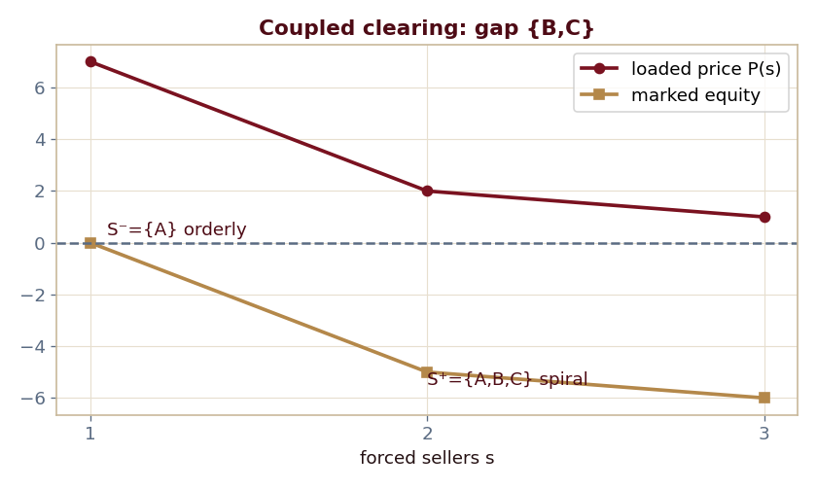
The key result
Every number reproduced by the seeded engine — notebook, workbook, and webapp agree by construction.

Slide 4
What the module computes
P(s)=max(12−5s,1); forced when 2+P(s)−9<0
From {A}: S⁻={A} (orderly), price 7
From all: S⁺={A,B,C} (spiral), price 1
Gap {B,C}; tolerated-failure count = 1
ch13 · 8/8 PASS
Validation checks accompany every laboratory report.

