Slide 1
CHAPTER 14
Institutions & the Design of Gates
Part V · Institutions, Markets, Equilibrium
K
→
𝒢
→
Q
→
Ξ
Mathematical Theory of Capital · Companion Course

Slide 2
Chapter at a glance
Institutions are gate-writers. Where to place a gate, whether to toll the interior, how to price the last resort — the whole book becomes a design problem.
The laboratory module
Module 14 — The Designer's Desk · Optimal gate, Bagehot band
◈
Notebook
Rendered, with charts
▤
Workbook
Live Excel formulas
▦
Webapp
Interactive module

Slide 3
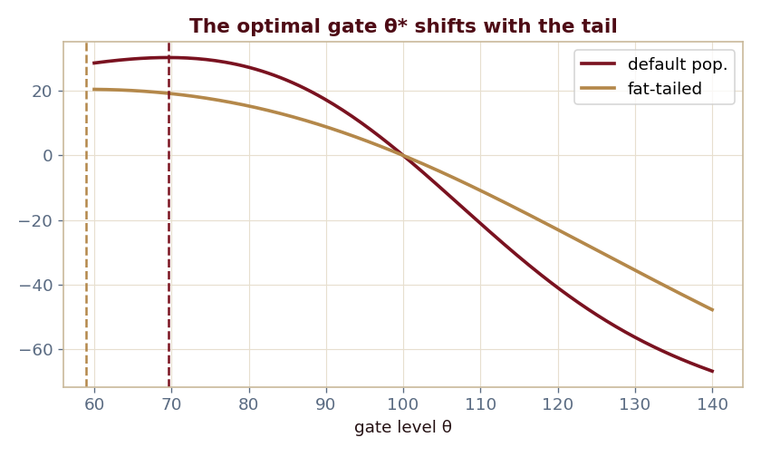
The key result
Every number reproduced by the seeded engine — notebook, workbook, and webapp agree by construction.

Slide 4
What the module computes
Optimal gate θ* balances screening benefit vs pressure
Neutrality: optimal burdens sit at the boundary
An interior toll is deadweight (absent congestion)
The Bagehot band prices the last resort
ch14 · 8/8 PASS
Validation checks accompany every laboratory report.

