Slide 1
CHAPTER 16
Equilibrium & the Frontier Registry
Part V · Institutions, Markets, Equilibrium
K
→
𝒢
→
Q
→
Ξ
Mathematical Theory of Capital · Companion Course

Slide 2
Chapter at a glance
The map nobody owns. Architectures compete with twin equilibria — thin maps and thick maps. The dynamic frontier: fractals, chaos, regime-switching, punctuation.
The laboratory module
Module 16 — The Cartographer's Commons · The dynamic frontier
◈
Notebook
Rendered, with charts
▤
Workbook
Live Excel formulas
▦
Webapp
Interactive module

Slide 3
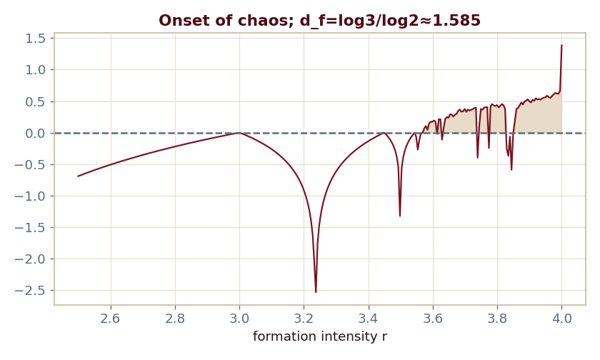
The key result
Every number reproduced by the seeded engine — notebook, workbook, and webapp agree by construction.

Slide 4
What the module computes
Fractal dimension d_f = log 3/log 2 ≈ 1.585
Pruned to d_f = 1.000 after gate-tightening
Logistic map period-doubles into chaos (λ>0)
Coordination gap opens for n=4 at R/F > 0.25
ch16 · 8/8 PASS
Validation checks accompany every laboratory report.

